Slide 1
TMDA Student Seminar
Data Fusion Techniques and Their Differences
—— KF，EKF，UKF，PF
Team: Zhenqiao Wang, Tianqi Xiao,
Yihui Yang

Slide 2

Data Fusion & KF
Extended KF
Unscented KF
Particle Filter
Differences & Comparison

Slide 3
1. Data Fusion Methods & Kalman Filter
What is data fusion?
Data fusion is the process of integrating multiple data sources to produce more consistent, accurate, and useful information than that provided by any individual data source.
—— Haghighat, Mohammad
“Data fusion”
How to classify data fusion?
1. Data in-data out (DAI-DAO);
2. Data in-feature out (DAI-FEO);
3. Feature in-feature out (FEI-FEO, Feature fusion);
4. Feature in-decision out (FEI-DEO);
5. Decision in-decision out (DEI-DEO, Decision fusion).
—— Dasarathy's Classifcation

Slide 4
1. Data Fusion Methods & Kalman Filter
Multi-sensor measuring system
Multi-source data acquisition
Observation 1
Observation 2
Initial state
+
Control-inputs / disturbances
Observation with noise
Observation 3
State transition /
Prediction model
......
State parameters
Observation model
How to weighting ? ?
Correction / Update

Slide 5
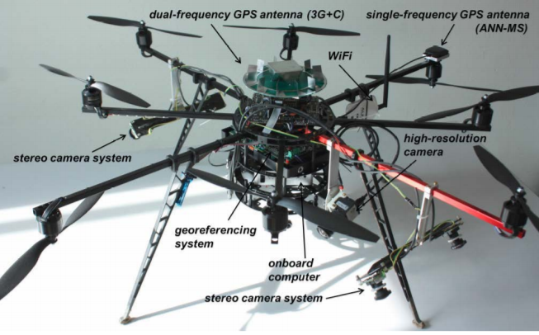
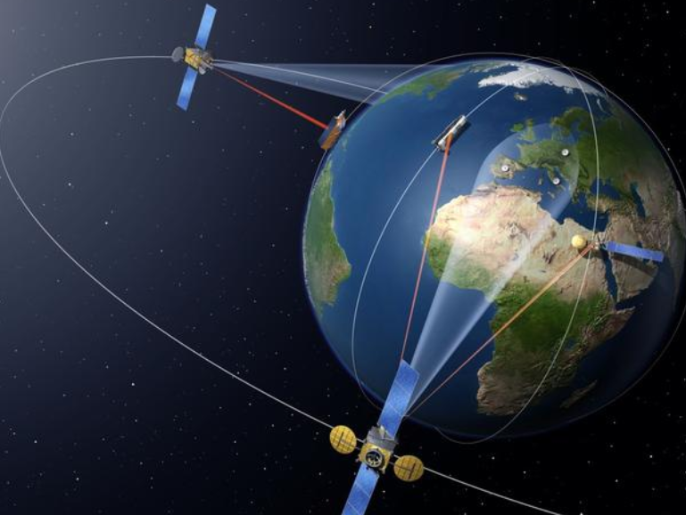
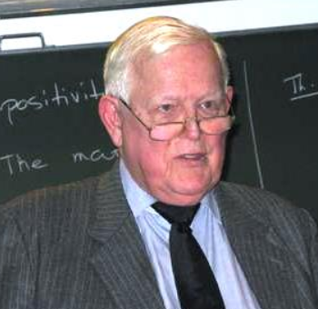
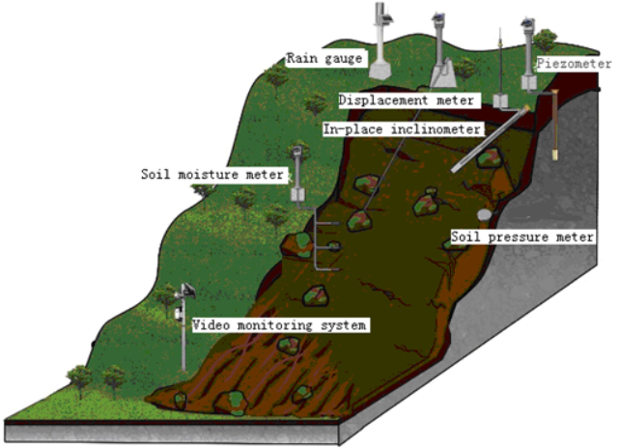
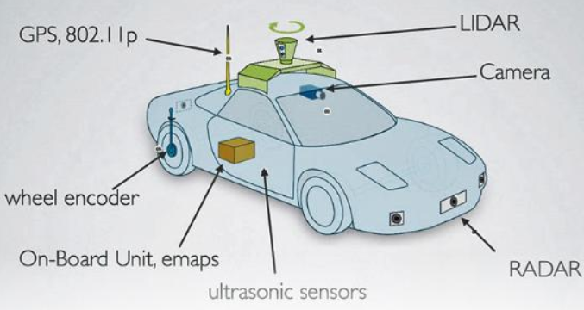
1. Data Fusion Methods & Kalman Filter
What is Kalman filter?
Kalman filter (KF) is an algorithm that uses a series of measurements observed over time, containing statistical noise and other inaccuracies, and produces estimates of unknown variables that tend to be more accurate than those based on a single measurement alone.
Application:
Dynamic positioning
Objects tracking
Monitoring and prediction
Orbit determination
Navigation system
Multi-sensor fusion
......
Source: KLINGBEIL, L., 2014
Rudolf Emil Kálmán (1930 – 2016)
......
Source:
http://www.cnasit.com/product_geotechnical/46.html?lang=en

Slide 6
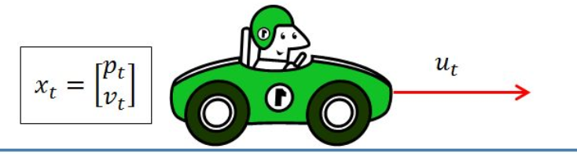







1. Data Fusion Methods & Kalman Filter
Linear system

Slide 7
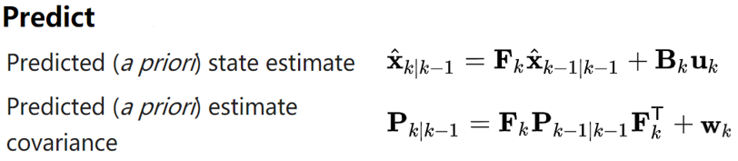

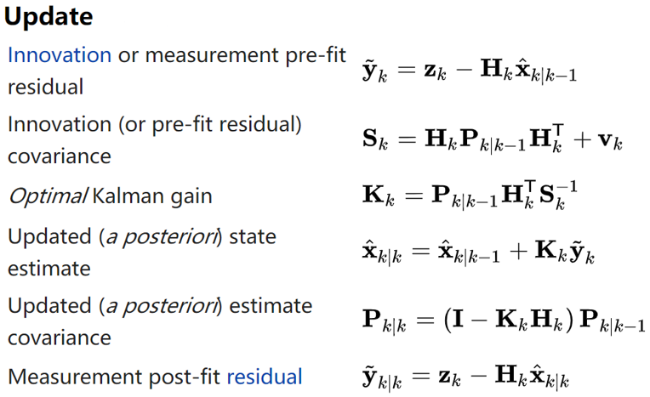

1. Data Fusion Methods & Kalman Filter
General process of KF:
F, B, H, Q, R are constant!
The initial state and noise vectors at each step are all assumed to be mutually independent.

Slide 8
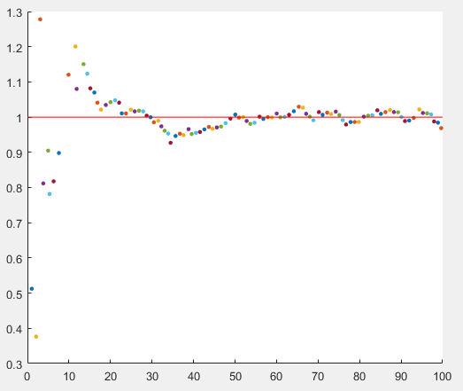
1. Data Fusion Methods & Kalman Filter
A simple example implemented in MATLAB:
Z=(1:100);
noise=randn(1,100); % Gaussian noise with variance 1
Z=Z+noise; % Observation
X=[0; 0]; % State parameters
Sigma = [1 0; 0 1]; % Covariance matrix of state estimate
F=[1 1; 0 1]; % State transition matrix
Q=[0.0001, 0; 0 0.0001]; % Covariance matrix of state transition
H=[1 0]; % Observation matrix
R=1; % Observation noise variance
figure;
hold on;
for i=1:100
X_ = F*X;
Sigma_ = F*Sigma*F'+Q;
K = Sigma_*H'/(H*Sigma_*H'+R);
X = X_+K*(Z(i)-H*X_);
Sigma = (eye(2)-K*H)*Sigma_;
plot(X(1), X(2), '.','MarkerSize',10); % Draw real-time update state parameters
end
plot([0,100],[1,1],'r-'); % Draw real state parameters
Generated by MATLAB 2019a
Gradual convergence!

Slide 9
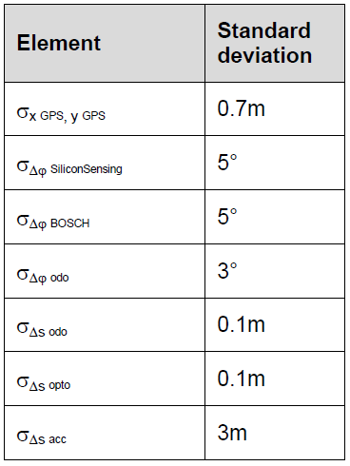
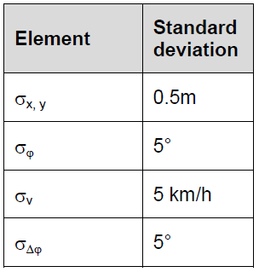
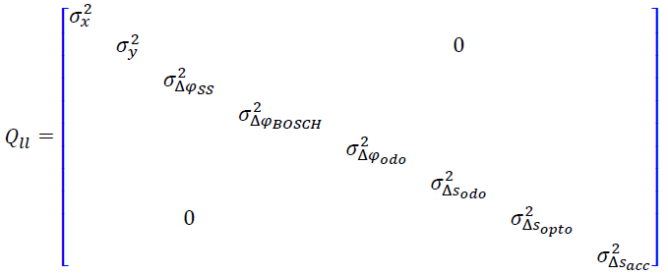
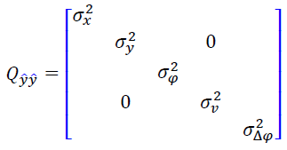
1. Data Fusion Methods & Kalman Filter
Difficulties of Kalman Filter?
Accurate or Inaccurate ? Divergence or Convergence ?
Practical implementation of the KF is often difficult due to the difficulty of getting a good estimate of the noise covariance matrices Q_{k} (Prediction Covariance) and R_{k} (Measurement Covariance). Extensive research has been done in this field to estimate these covariances from data. One practical approach is the Adaptive Kalman Filter (AKF) technique that can estimate the statistic characteristic of noise using observation information at the same time of estimating state parameters to revise or adjust the covariance matrix.
Error propagation law; Symmetric matrix; Empirical; Adjustable; Adaptive...

Slide 10




2. Extended Kalman Filter
Limitations of Kalman Filter?
Two assumptions:
1. Kalman Filter will always work with Gaussian Distribution. —— Q , R
2. Kalman Filter will always work with Linear Functions. —— F , B , H
Gaussian distribution is no longer Gaussian after nonlinear transformation, but Kalman Filter can only filter the white Gaussian noise (WGN).
Example: The relationship between the pseudo range and position of GPS receiver
: State vector, position of receiver and clock difference.
: Position of satellite.
In this equation, the state vector and its coefficient are inseparable, so it cannot be written in the form of , only .

Slide 11
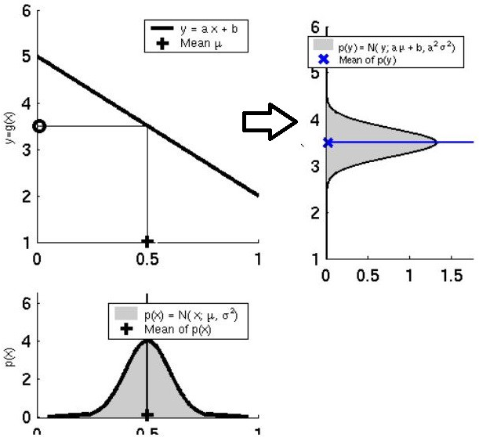
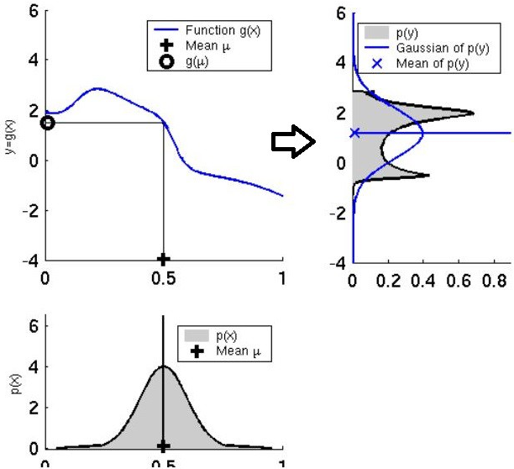
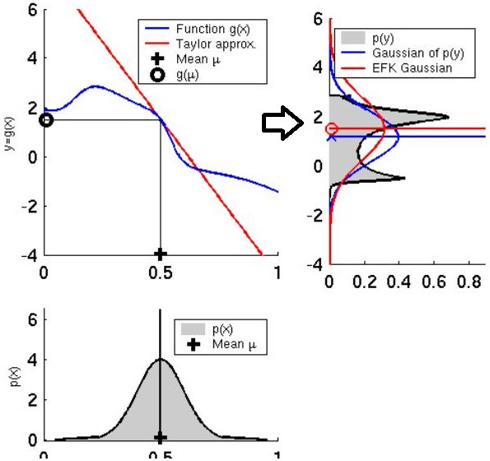
2. Extended Kalman Filter
Solution for the nonlinearity in Kalman Filter?
1. Linearization ——> Taylor Series ——> Jacobian Matrix
2. The rest part is almost the same as General Kalman Filter.
Establishing a linear approximation for the non-linear function.
Source: https://towardsdatascience.com/extended-kalman-filter-43e52b16757d

Slide 12
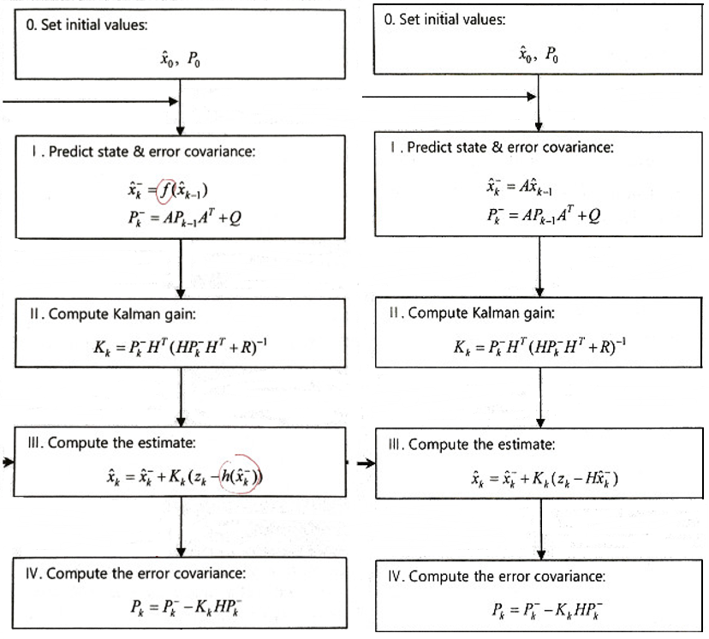
2. Extended Kalman Filter
The Jacobian matrix (F, G) is the first order derivative in Taylor Series around the mean of the Gaussian distribution.

Slide 13

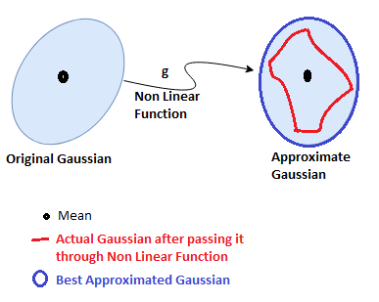
3. Unscented Kalman Filter
Problems of Extended Kalman Filter?
1. Only 1 point is taken in EKF to approximate a new linear function from non-linear function, which is the mean of the Gaussian Distribution for current state ;
2. The higher order terms are lost in linearization by Taylor Expansion.
The results (estimate and covariance) by EKF are not so accurate！
Source: https://towardsdatascience.com/the-unscented-kalman-filter-anything-ekf-can-do-i-can-do-it-better-ce7c773cf88d

Slide 14
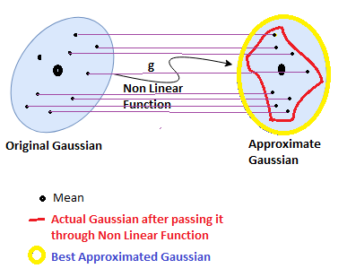
3. Unscented Kalman Filter
We can take some points on source Gaussian and map them on target Gaussian after passing points through some non-linear function (observation function) and then calculate the new mean and variance (state distribution) of transformed Gaussian.
The main difference from EKF is that in EKF we take only one point (i.e. mean) to approximate, but in UKF we take a bunch of points called weighted sigma points.
Source: https://towardsdatascience.com/the-unscented-kalman-filter-anything-ekf-can-do-i-can-do-it-better-ce7c773cf88d

Slide 15
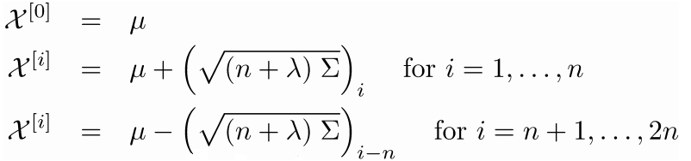
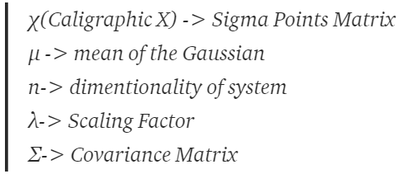
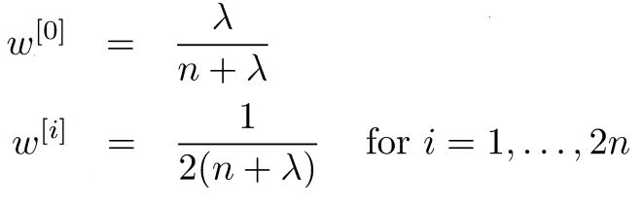
3. Unscented Kalman Filter
Steps of the unscented transform:
1. Compute Set of Sigma Points (to captures the true mean and covariance completely);
2. Assign Weights to each sigma point;
3. Transform the points through non linear function;
4. Compute Gaussian from weighted and transformed points;
5. Compute Mean and Variance of the new Gaussian.
Sum of all the weights is equal to 1.

Slide 16
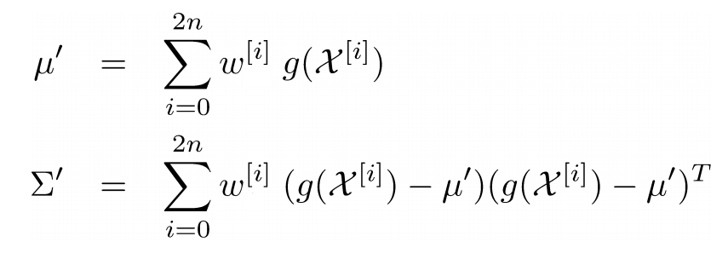
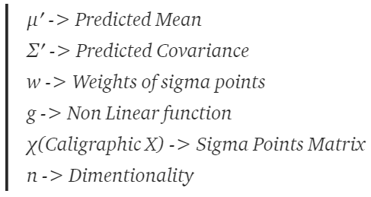
3. Unscented Kalman Filter
Prediction Step:
1. Calculate Sigma Points;
2. Calculate Weights of Sigma Points;
3. Transforming Sigma Points and Calculate new Mean and Covariance.

Slide 17
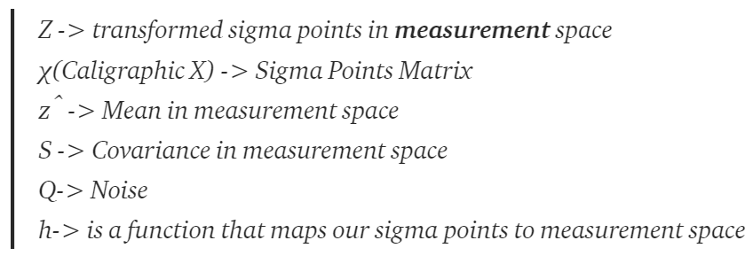
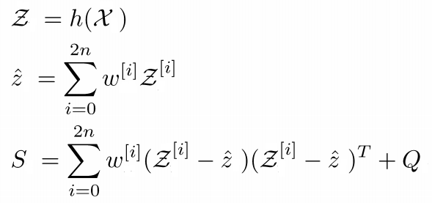
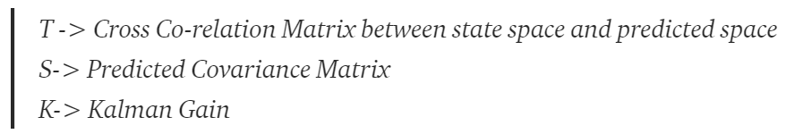
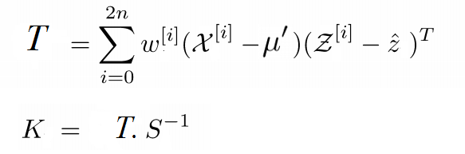
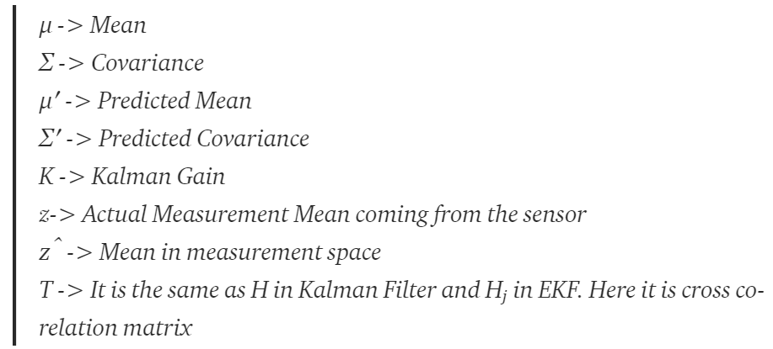
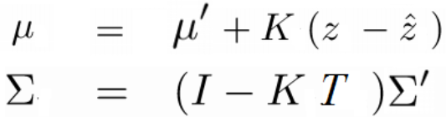
3. Unscented Kalman Filter
Update Step:

Slide 18
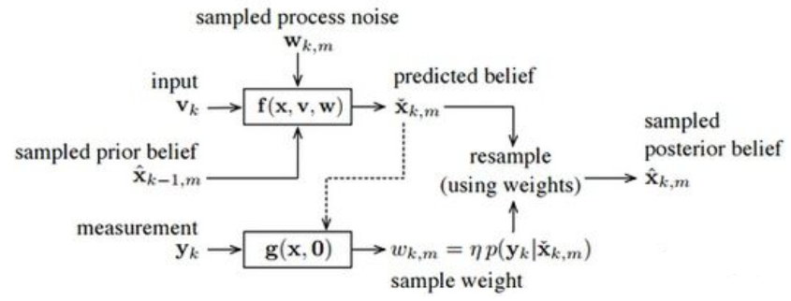
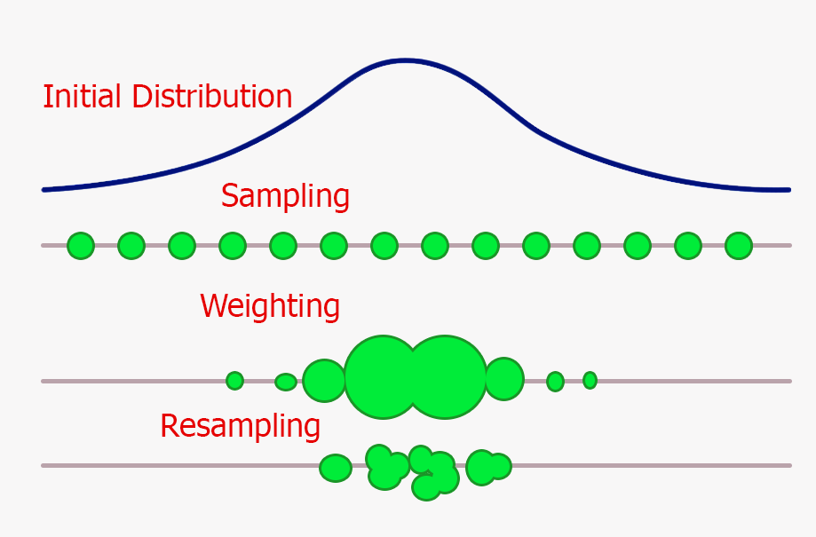
4. Particle Filter
One problem of UKF is that the outputs are still assumed to be Gaussian. However, even in a very simple case, the result of nonlinear transformation is not Gaussian.
Source: Arulampalam, M 2002
Source: Pier Paolo Ippolito 2019
The particles which is more consistent to the observation will have higher weight, and the higher weight they have, the easier can be picked up during resampling.
The final estimation is the result of a weighted sum of all of the particles.

Slide 19
5. Differences & Comparison
Kalman Filter: only is effective for linear system, but simple and very fast.
Extended Kalman Filter: can be used in nonlinear system, but low accuracy under strongly nonlinear system.
Unscented Kalman Filter: can be used in nonlinear system with better performance and faster convergence, and needn't linearization.
Particle Filter: can cope with nonlinear dependencies and non-Gaussian densities in the dynamic model and in the noise error with very good performance, but not so fast for its complex steps and parameter setting.

Slide 20

References
[1] Castanedo F. “A Review of Data Fusion Techniques”. 2013.
[2] https://en.wikipedia.org/wiki/Kalman_filter
[3] Q. Li, R. Li, K. Ji and W. Dai, “Kalman Filter and Its Application”. 2015.
[4] Simon J. Julier and Jeffrey K. Uhlmann. “New extension of the Kalman filter to nonlinear systems”. 1997.
[5] Wan, Eric A., and Rudolph Van Der Merwe. "The unscented Kalman filter for nonlinear estimation". 2000.
[6] Arulampalam, M. Sanjeev, et al. "A tutorial on particle filters for online nonlinear/non-Gaussian Bayesian
tracking". 2002.
[7] https://towardsdatascience.com/kalman-filter-interview-bdc39f3e6cf3

Slide 21
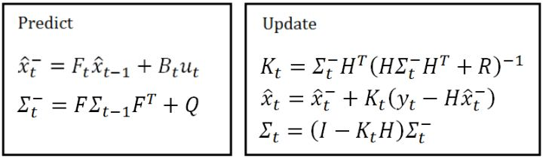
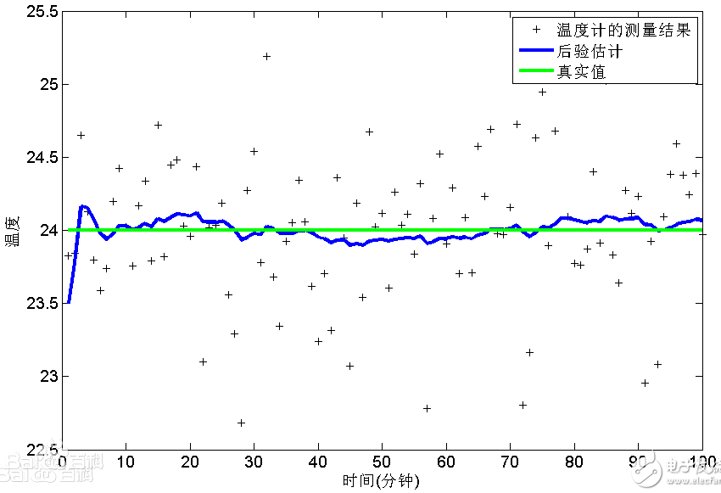
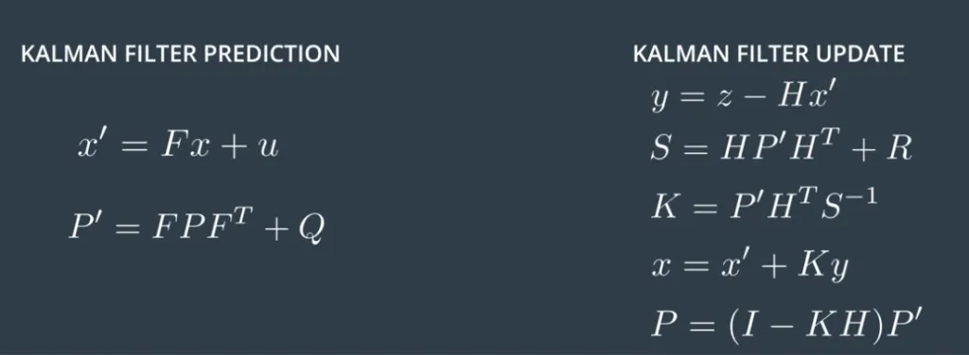
Vielen Dank ！

